Slide 1
Emerald Group Publishing
Research & Publishing
RADKA MACHKOVA
Business Manager – South Easter Europe
1 April 2014

Slide 2
Emerald Group Publishing Ltd
Emerald is a leading independent publisher of global research with impact in business, society, public policy and education
Over 40 years experience as a scholarly publisher
Established in 1967 by a group of academics from
the Bradford School of Management (UK)
The world’s leading scholarly publisher of journals
and books in business and management
In 2014 Emerald publishes almost 300 journals and
over 1000 textbooks and eBook Series

Slide 3

Be different, do different ...
We show commitment to quality through excellent service and support resources.
We build strong relationships with…
.
more than 100,000 advisers, authors and editors
and nearly 5,000 customers
in 130 countries
worldwide

Slide 4



Quality research
Emerald is proud to say that:
We have authors from all of the FT top 100 business schools
We have
211 journals
&
111 book series ranked in Scopus
We have
58 journals
& 3 book series indexed in Thomson Reuters (ISI)

Slide 5
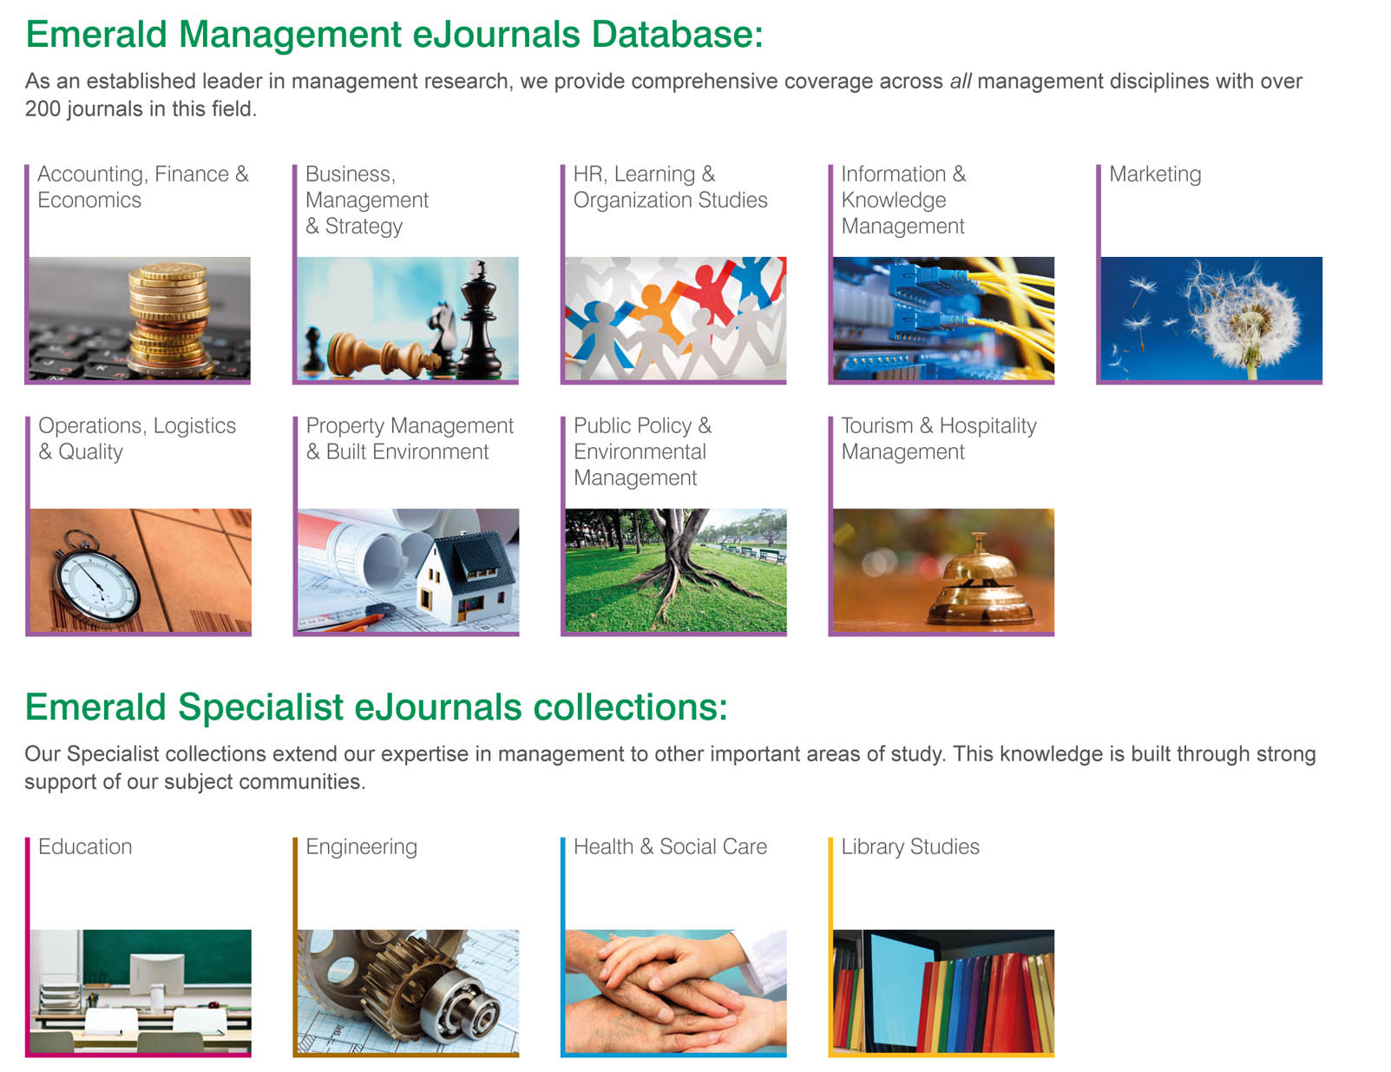
Emerald eJournals
.

Slide 6


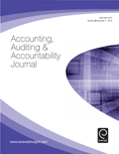

Emerald’s new journals on ISI
As a publisher we work closely with our subject communities to launch high quality new journals in exciting and innovative
A number of our recently launched journals have already been indexed by Thomson Reuters (ISI):
Leadership & Organization Development Journal (2013)
Employee Relations (2013)
Accounting, Auditing & Accountability Journal

Slide 7



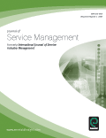
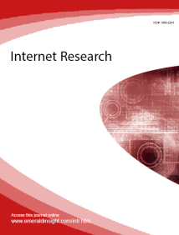
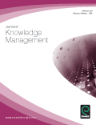
High quality ISI journals
As well as new ISI launches, many of our existing journals are also indexed by Thomson Reuters (ISI)
Journals with the highest impact factors:
Supply Chain Management
Impact factor 1.684
Industrial Management & Data Systems
Impact factor 1.674
Journal of Physical Distribution & Logistics Management
Impact factor 1.826
Journal of Service Management
Impact factor 1.864
Internet Research
Impact factor 1.5
Journal of Knowledge Management
Impact factor 1.474
2012 Impact factor rating

Slide 8



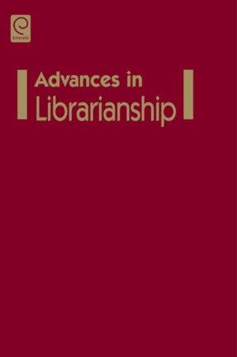

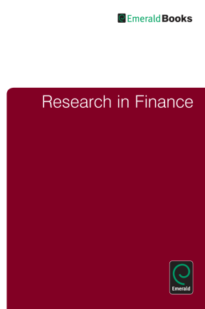
Emerald eBook Series Collection:
Business, Management and Economics
High quality, international research …
Key eBook Series titles:
Featuring unique, international and high quality content, this collection reinforces Emerald’s position as a world leading publisher in business and management research. It is made up of more than 890 volumes from over 85 eBooks Series titles in the following subject areas:
These 7 subject areas are covered
Accounting, Finance & Economics
Business, Management & Strategy
HR, Learning & Organization Studies
Library & Information Management
Public Policy & Environmental Management
Healthcare Management
Tourism & Hospitality Management

Slide 9
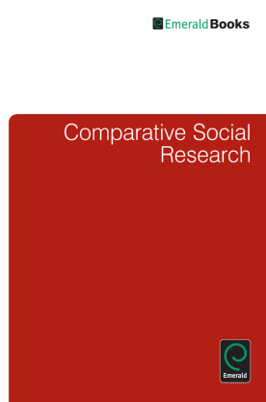
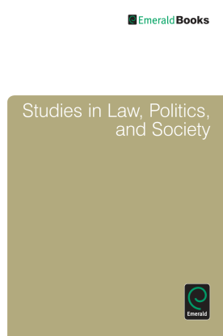


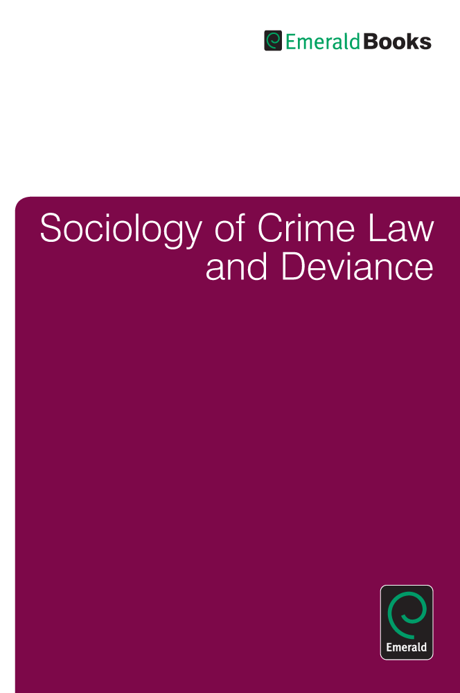

Emerald eBook Series Collection:
Social Sciences
High quality, international research …
Key eBook Series titles:
Emerald SSe eBook Series Collection currently offers online access to more than 400 volumes from over 50 book series titles.
These 3 subject areas are covered
Education
Health & Social Care
Sociology and Public Policy.

Slide 10













Support for Your Library
Industry Standards Compliant
Discovery
Citation Management
Usage statistics
Authentication

Slide 11

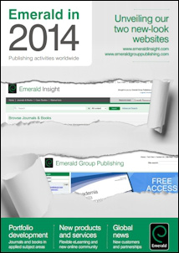
Be different, do different ...

Slide 12
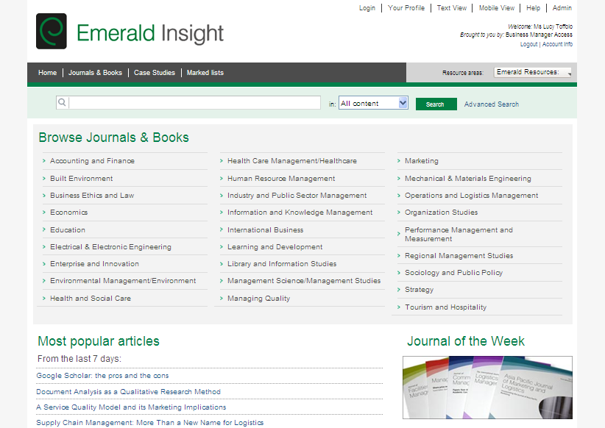
New Platform www.emeraldinsight.com
Notes:
Our Journal of the Week feature allows you to access all articles from our selected title free of charge

Slide 13

Brand new training program offering comprehensive, constructive advice and training on pertinent aspect of academic research
More then 10 core modules options including Academic Writing, Writing for Publication, Essentials of a Quality Paper, Research Evaluation, Science Publishing, Research Strategy….

Slide 14
Questions?
Your local Emerald representative:
Radka Machkova
Business Manager - Slovakia
+420 608980867
RMachkova@emeraldinsight.com

